Slide 1
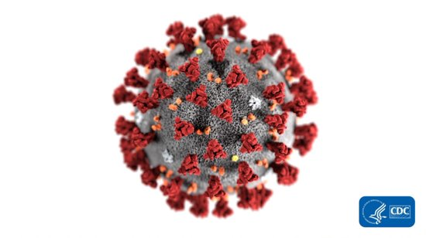
Novel Coronavirus Outreach
Presentation
Webinar March 20, 2020
Public Health – Seattle & King County
Debra Baker – Speakers Bureau Lead

Slide 2
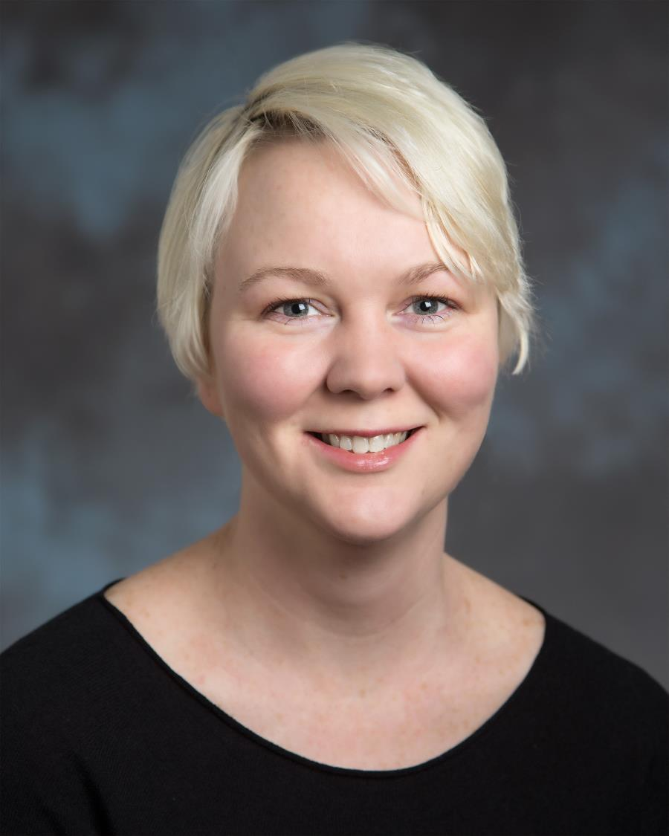
Speakers
Shannon Harris, MPA, MPH, is an Special Projects Manager with King County Human Resources. She is currently supporting the COVID-19 Response efforts in various capacities. She was a doula for 8 years.
Notes:
-

Slide 3
What is novel coronavirus (COVID-19)?
For the latest information on the coronavirus check the CDC website: https://www.cdc.gov/

Slide 4
What Can We Do?
Our goal is to slow the spread of this virus!
There is no vaccine for this virus yet. Experts are working on it.
The goals of these actions are to:
Reduce the number of people infected and the number of deaths caused by COVID-19
Minimize the social and economic impacts of COVID-19 on communities
Protect individuals at risk for severe illness, including older adults and people with underlying
Notes:
Read the slide

Slide 5
Public Health Orders - Gatherings
Under the Health Officer’s order in King County:
Events with more than 50 attendees are prohibited.
Public events with fewer than 50 attendees are prohibited, unless event organizers can take these steps:
Older and vulnerable individuals have been encouraged not to attend
Recommendations for social distancing and limiting close contact (6ft for 10 min) are met
Employees or volunteers leading an event are screened for symptoms each day
Proper hand washing, sanitation, and cleaning is readily available
Environmental cleaning guidelines are followed (e.g., clean and disinfect high touch surfaces daily or more frequently)
All public and private schools are closed from March 17 through April 24 to help slow the spread of coronavirus

Slide 6
Public Health Orders - Gatherings
All bars, dance clubs, fitness and health clubs, movie theatres, night clubs, and other social and recreational establishments are closed.
All restaurants and food service establishments are drive-through, take-out and delivery services only.
Retail businesses and service operators such as grocery stores, drug stores, and other essential services remain open for now.
Notes:
In order to keep the virus from spreading we have issued new guidance.

Slide 7
Public Health Orders - Gatherings
All bars, dance clubs, fitness and health clubs, movie theatres, night clubs, and other social and recreational establishments are closed.
All restaurants and food service establishments are drive-through, take-out and delivery services only.
All other retail, including banks, grocery stores, hardware stores, and pharmacies, should and may remain open provided they observe the COVID-19 prevention measures and adhere to the Seattle and King County Guidance for retail businesses and service operators.

Slide 8
Who is most at risk of severe illness?
Let’s keep in mind most people have mild illness.
That said, risk factors for severe illness may include:
Older age (60+) … this includes healthy people
Underlying chronic medical conditions… managed or unmanaged
Weakened immune systems… cancer, organ transplants, skin conditions, immunosuppressive therapy
Pregnancy
Children may have less severe illness, but can put others at risk
People at higher risk of severe illness should especially stay home

Slide 9
What are the symptoms?
Fever
Difficulty breathing
People who have been diagnosed with novel coronavirus have reported symptoms that may appear in as few as 2 days or as long as 14 days after last exposure to the virus.
There is no vaccination yet.
Cough

Slide 10
How Does Novel Coronavirus Spread?
6ft or less
Virus can live on surfaces for several days.
What is the incubation period?

Slide 11
What are Epidemic and Pandemic?
Epidemic - Outbreak (epidemic) is more local. Epidemic refers to an increase, often sudden, in the number of cases of a disease above what is normally expected in that population in that area
Pandemic - Pandemic refers to an epidemic that has spread over several countries or continents, usually affecting a large number of people.
Source: The CDC https://www.cdc.gov/csels/dsepd/ss1978/lesson1/section11.html

Slide 12
Slowing the Spread of Coronavirus

Slide 13
Steps to Reduce Risk of Spread - Have a healthy hygiene practice-
Do not go to the emergency room
Practice excellent hygiene habits
Clean frequently touched surfaces and objects
Stay home when
you are sick
Avoid contact with people who are sick
Vulnerable groups avoid large gatherings
Stay informed

Slide 14
Reduce Risk of Spread Cleaning and Disinfecting Surfaces
Can last up to several days on a surface
At least 2x per day for frequently touched surfaces: Desktops and all work surfaces, doorknobs and door handles, Light switches and dimmer switches, computer monitors, keyboards, mice, tablets and laptops, telephone equipment, all chair rests and arms, cafeteria/eating tables and chairs, crockery, trays and cutlery, sinks, taps and kitchen areas, toilets, water fountains and drinks dispensers and vending machines, elevators and their doors and buttons.
Community Facilities with Suspected/Confirmed Coronavirus Disease 2019: https://www.cdc.gov/coronavirus/2019-ncov/community/organizations/cleaning-disinfection.html
Notes:
.

Slide 15
What are Isolation and Quarantine?
Isolation: separation of people who are currently ill and able to spread the disease and who need to stay away from others in order to avoid infecting them.
Quarantine: separation of people who are not currently showing symptoms but are at increased risk for having been exposed to an infectious disease; for people who become sick and spread the infection to others
Home isolation or quarantine is always the preferred choice

Slide 16
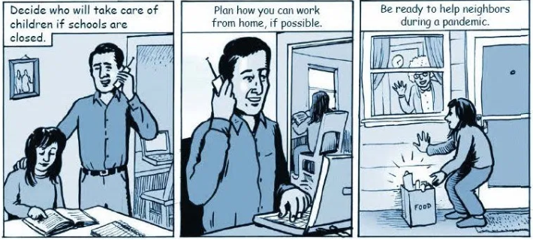
What can you do as an individual?
Clean frequently touched surfaces and objects
Plan to have extra supplies of important items on hand
Plan ways to care for those at greater risk for serious complications
Check on your staff
Get to know your neighbors
Schedule virtual time with friends and family.

Slide 17
Please donate blood
Donating blood is a safe activity.
Bloodworks Northwest’s policies comply with FDA, CDC, local health departments, and other recommendations related to COVID-19.
All healthy individuals are strongly encouraged to schedule appointments and keep commitments to donate blood.
Bloodworks Northwest has more information on coronavirus, who is eligible to donate blood, and donation locations at www.bloodworksnw.org/coronavirus

Slide 18
Things That Keep Us Healthy
Find ways to have social interaction
Eat healthy diet
Get sleep – this helps your immune system
Get fresh air
Mindfulness techniques
Stretching/yoga
Call to check in on people in your community
Keep kids active when they aren’t in school
Nearby park
Walks around neighborhood
Games to play
Dance party at home

Slide 19
Who Should Seek A Medical Evaluation?
If you have symptoms like fever, cough, or difficulty breathing, call your healthcare provider. Do not go to the emergency room.
If you do not have a provider, call a Public Health Clinic: https://www.kingcounty.gov/depts/health/locations.aspx
If you are having a medical emergency, call 9-1-1.
Note that call volume may be very high; we thank you for your patience in getting through to a call taker.

Slide 20
Call Centers
King County Novel Coronavirus Call Center, 206-477-3977 8 a.m. – 7 p.m. daily
Washington State Novel Coronavirus Call Center, 800-525-0127 and press #. 6 a.m – 10 p.m. daily
The operators are able to connect with a third-party interpreter. The caller will need to be able to tell them in English what language you need for interpretation.
Notes:
.

Slide 21
Employees to Stay Home When Sick
Community benefits to telecommuting and/or temporarily closing
businesses
Reduce additional exposure to frontline employees who often have access to fewer resources to handle being sick
Model trust that work can get done remotely just as well
Center human health in a compassionate way by caring for others’ health
Good for the environment
Consider pandemic planning job duties that people can do to support the organization from home.
Work with funders to shift any contract deliverables
Paid sick leave: https://www.kingcounty.gov/depts/health/communicable-diseases/disease-control/novel-coronavirus/anti-stigma.aspx
Notes:
Read the slide

Slide 22
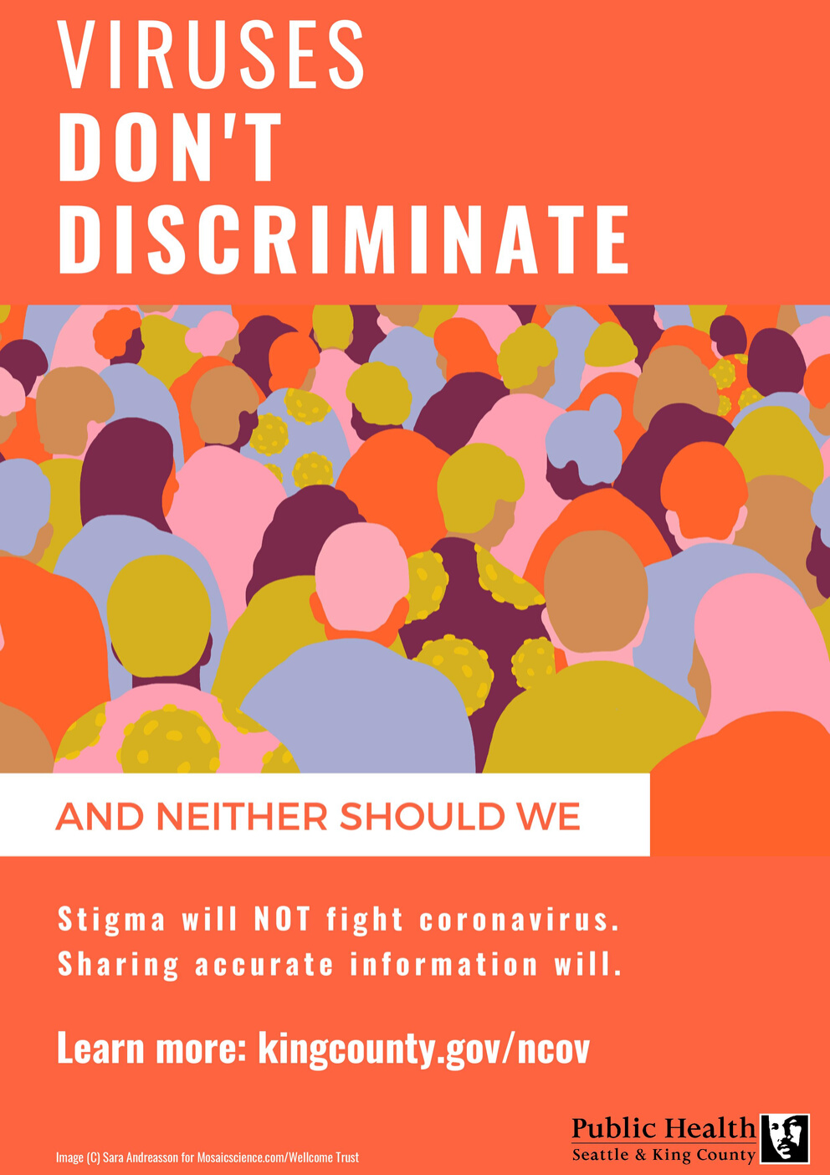
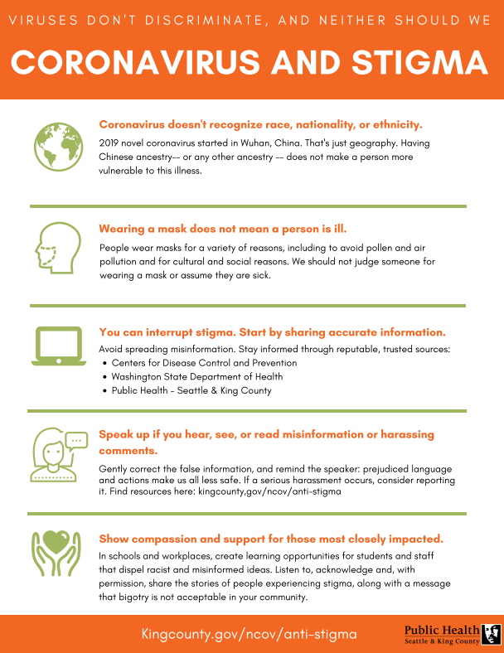
What can you do if you see stigma or bias?
Find these resources and more at:
https://bit.ly/2Vm455V

Slide 23
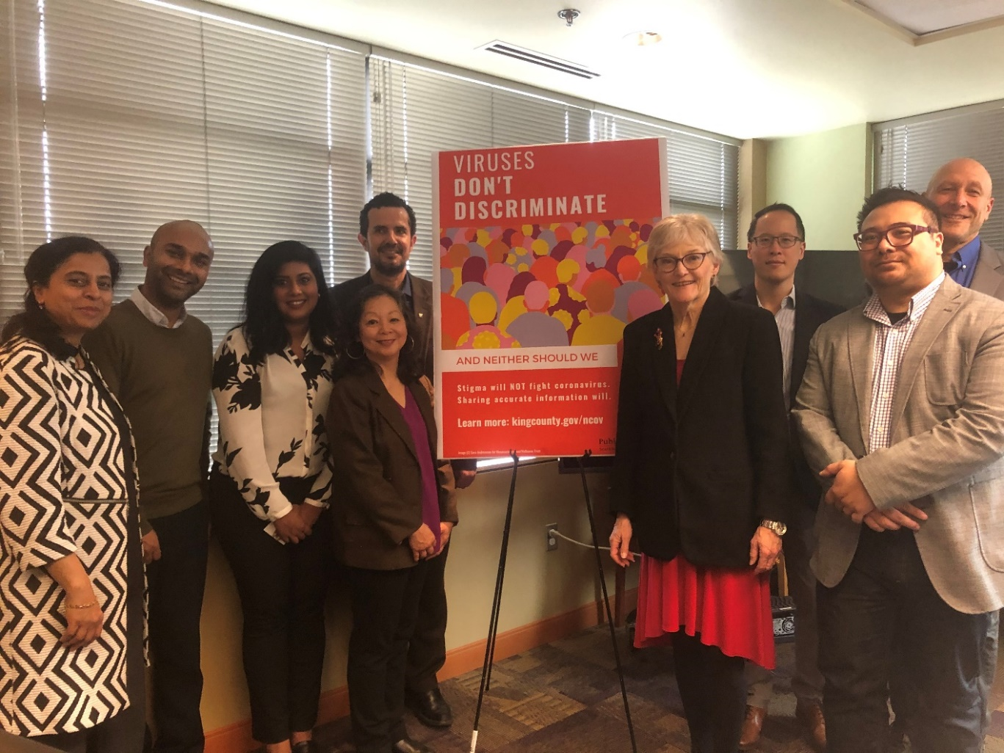
What is Public Health doing?
Conducting disease surveillance & investigation
Coordinating services for cases under isolation and quarantine
Disseminating messages and materials
Engaging with communities who might be most impacted

Slide 24
Public Health Response Structure – Community Mitigation Branch (reducing spread)
Community Mitigation Branch - Director Matias
Deputy
Non-pharmaceutical intervention group supervisor
Pandemic Community Advisory Group
Houseless Task Force
Business Task Force
Kirsten
Wysen
Children & Youth Task Force
Govern-ment Task Force
Community & faith-based Task Force Candace
Jackson
Behavioral Health Task Force
Speakers bureau
Debra
Baker
Penny
Lara

Slide 25
Communications – what Public Health is working on
Updating the guidance on new Health Order (15 languages)
Working on systems to better capture, prioritize, & respond to translation requests
Webinars in languages other than English (Spanish, Vietnamese, Chinese, Somali)
And more

Slide 26
Updated Guidance – Public Health-Seattle & King County
www.kingcounty.gov/covid - Under “Resources”

Slide 27
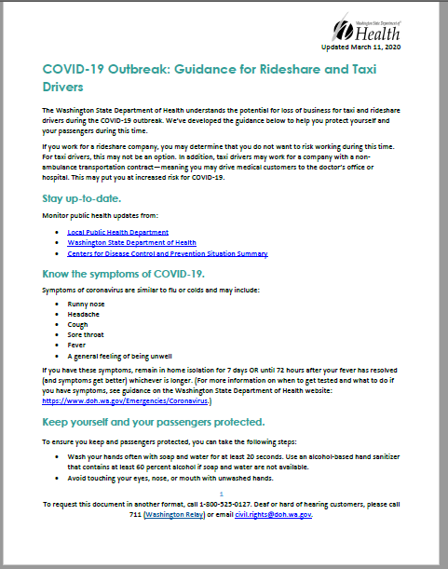
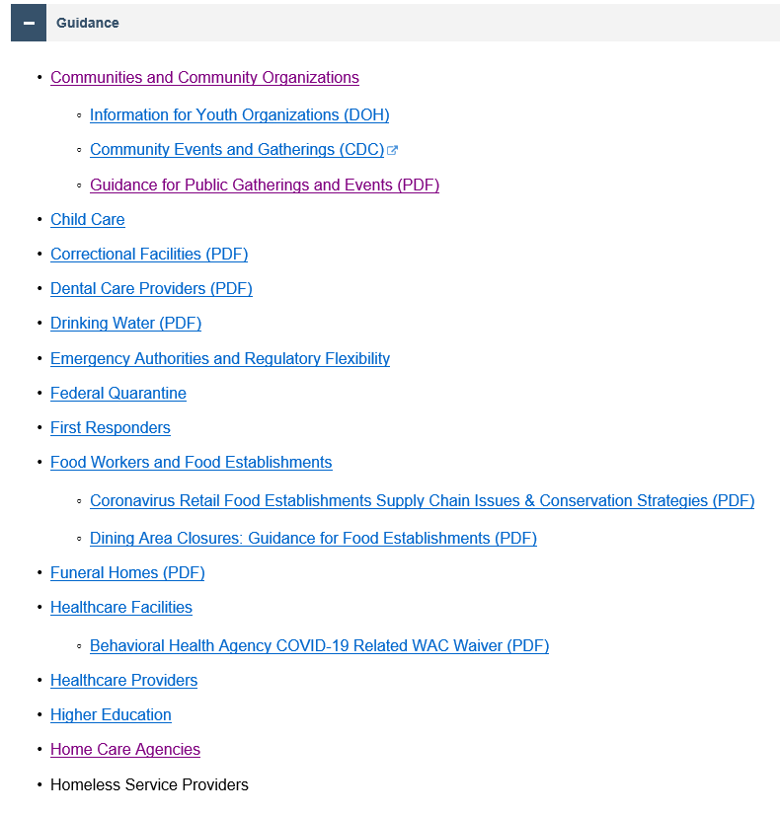
Washington State Dept. of Health (DOH) Guidance
https://www.doh.wa.gov/Emergencies/Coronavirus
Available as PDFs; content is in English
Many topics; updated regularly

Slide 28
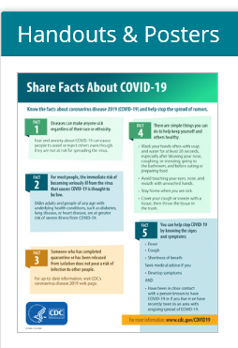
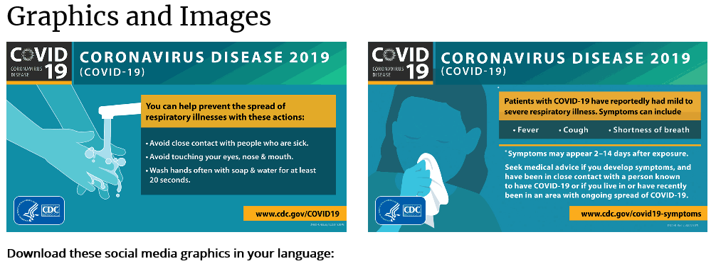
CDC Communication Resources
https://www.cdc.gov/coronavirus/2019-ncov/communication/index.html
Posters (English, Spanish, Simplified Chinese)
Button for your website
Social media graphics (English, Spanish, Simplified Chinese)

Slide 29
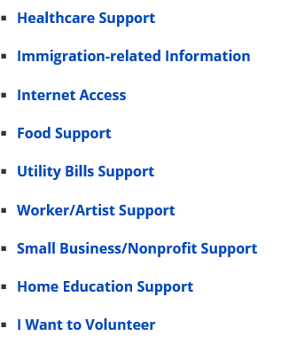
Matching Needs and Resources
http://www.seattle.gov/mayor/covid-19
This page contains information and links for City of Seattle programs and services that may be helpful for residents significantly impacted by the COVID-19 pandemic. Also listed below are community, county, and state resources that may be helpful to you. Some of these programs and services are available to everyone regardless of where you live. Although other restrictions may apply.
Notes:
.

Slide 30
Matching Needs and Resources
WA State new website: www.coronavirus.wa.gov
Exploring donation/resource exchange platform (King County Emergency Management)
Thoughts and reactions? How to center on equity? How to make connections more rapidly?
Notes:
.

Slide 31
Notes:
This is information about workplace rights.

Slide 32
How to stay informed
Information is changing frequently
Check and subscribe to Public Health's website www.kingcounty.gov/COVID
Common questions by audience
Downloadable fact sheets in multiple languages
Call center information (King County & WA State Dept of Health)
When and how to seek medical evaluation and advice
Subscribe to the blog www.publichealthinsider.com
Provides further context, rationale, and guidance
Translated Public Health and state helpline info: welcoming.seattle.gov/covid-19/
Notes:
If you aren’t subscribed to PH website, please do that immediately and encourage others to.
Blog provides more context and rationale around recommended measures.

Slide 33
QUESTIONS?
Public Health – Seattle & King County
Matias Valenzuela - Matias.Valenzuela@kingcounty.gov
Candace Jackson – Candace.Jackson@kingcounty.gov
Kirsten Wysen – Kirsten.Wysen@kingcounty.gov
For Coronavirus Presentations
If you have a group that would like this presentation, please have them contact: Debra.Baker@Kingcounty.gov
For more information visit: kingcounty.gov/covid

