Slide 1
COVID-19 Response
Balancing healthy birthing families with a system that is needed for critically ill patients.
March 2020

Slide 2
Areas of Discussion
INTRODUCTION TO RVCC
COVID-19 RESPONSE SYSTEMS
CARE OPTIONS
QUESTIONS

Slide 3
Birth bundle

Slide 4
Our current options
Birth Bundle for Clients entering care as long as providers and doulas are available
Lactation telemedicine
COVID-19 Specific Programs discussed in our next section
Family Planning visits discussed by our midwife in our third section today

Slide 5
Response now
[H2H]
Reduces Time in Hospital
Late Transfer of Care
Addresses needs of parents who are faced with last minute decisions in safe and appropriate way
Review of how to transfer into care
Jenn will talk about the provision of care next
Transfer prior to 28 weeks
Addresses needs of parents who want to pull back from hospital system either or both because of fears of increased exposure and/or desire to reduce burden on healthcare system
Review of how to transfer into care
Jenn will talk about the provision of care next
Provides extra attention for pregnancy with physician focus drawn to critical care
Allows parents to balance wants with fears and remain in control of decisions regarding place of birth
Reduces burden on healthcare system

Slide 6
How to enroll in our programs www.rv-cc.org/covid19

Slide 7
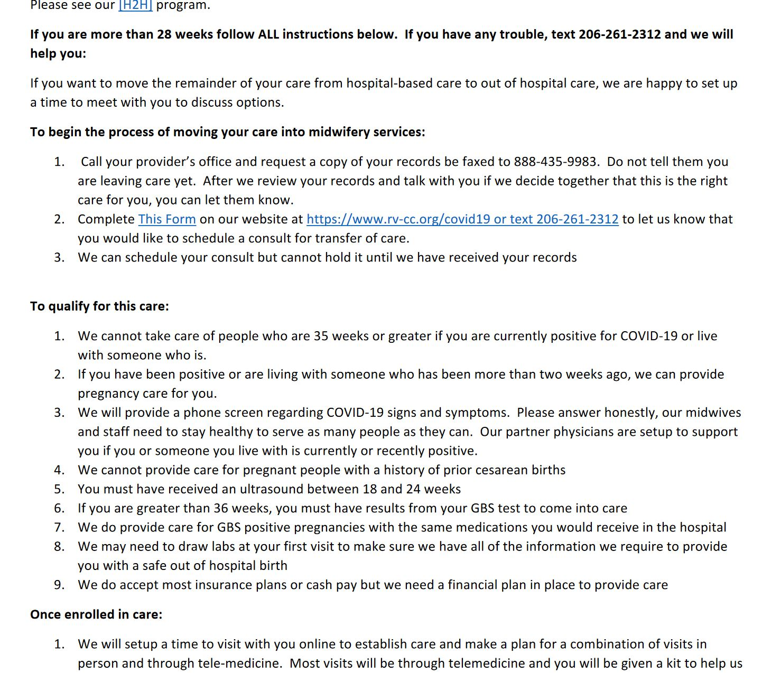
How to enroll in our programs www.rv-cc.org/covid19

Slide 8
Future possibilities
Consolidate Use of Energy
Rethink where families are birthing to bring healthy families into a clinic, home, or hotel setting that is repurposed for use as a birth center in order to consolidate use of midwives’ energy and time.
Larger Midwifery Team
Engage multiple groups of midwives to provide coverage in shifts, working in teams. Pairing experienced midwives with new midwives for support and extension of services.
Deploy CMAs and RNs to run visits under midwifery supervision
Use medical assistants and nurses to fan out for home visits. Place licensed midwives in call centers to do a televisit while the visiting healthcare worker runs assessment items and draws blood or administers other normal pregnancy tests or screens.

Slide 9
Provision of care: Home or birth center birth
ACCESSIBLE
On-call support from midwifery team from the time you enroll in our program with long visits to check in on all of you—your stress, your pregnancy, and your baby.
We focus on preparation for out of hospital birth and reducing fear, which causes you to hold your body tightly, which increases pain. Powerful remedies for fear are meaningful support and knowledge.
We like to say that knowledge is a very powerful analgesic!
PREDICTABLE
You will receive a care plan—a map of the care you will receive over the course of your pregnancy. You can rely on us to be there for you, respond to your needs, and stay connected with you, even between visits.
SAFE
We are committed to your safety.
Midwifery care allows you to receive all of your normal screens, tests and procedures. It offers medications as needed during labor, and provides screens and tests for your healthy newborn. Your postpartum care takes place in your home. If we feel at any time that you should be seen by a physician or in the hospital, we will get you quick access to that care without hesitation.

Slide 10
Provision of care: [h2h] home to hospital program
ACCESSIBLE
On-call support from our midwifery team from the time you enroll in our program with up to two televisits prior to labor to get to know each other and hear about your goals and hopes for labor and birth.
POWERFUL
One of the hardest parts of labor for many families is thinking it is time to go into the hospital only to find they are in very early labor. Knowing you can labor in the comfort of your own home, resting and nourishing yourself as you need, reassured by hearing baby’s heart beat and knowing your vitals are normal and healthy sets you up to be in your labor and birth from a place of strength.
SAFE
We are committed to your safety.
We will be available when you call, make a plan to come check in with you during your labor and will recommend you go to the hospital at the time that is right for you and baby.
We will provide you with a written record of your vitals and progress over time to bring with you to the hospital.

Slide 11
Evolving solutions: visit types
We do not offer testing for COVID-19 or see any patients who have suspected or known exposure or who are currently ill.
We currently offer three types of visits for prenatal, postpartum, and family planning care for healthy people
In-office visits.
We ask that only the client attend
We schedule one person at a time
We wipe down the clinic surfaces between each visit
We wear protective gear during the exam portion and practice social distancing during our conversation
At-home visits
We provide at-home visits where appropriate for points in care as needed
Telemedicine visits
Our clients consent to working with us online for care that does not require a screen, test, or procedure

